Slide 1
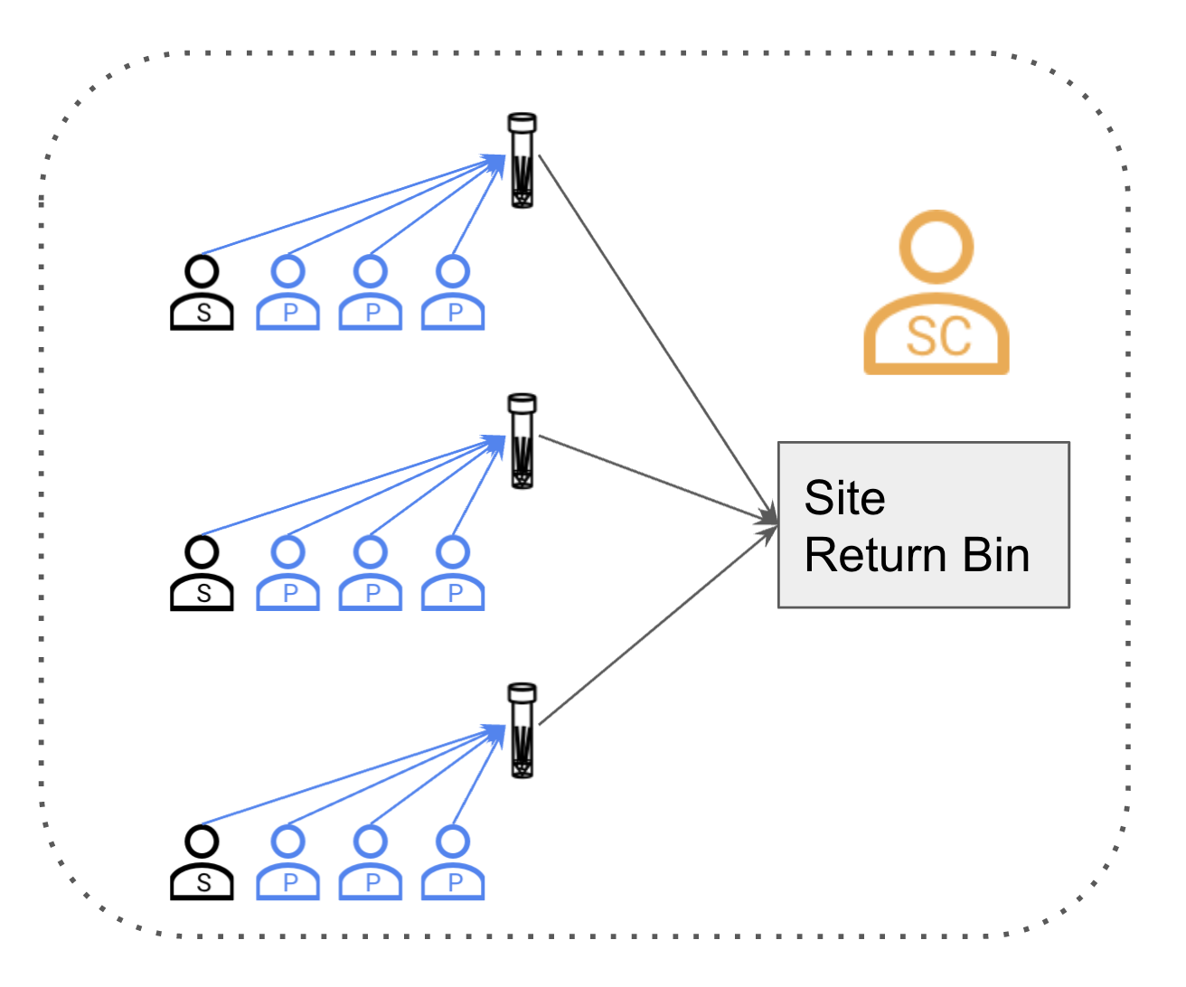
Overview
Site1
Self-swabbing by all participants according to procedures approved by medical director
Pools of 2 to 4 participants, preferably 4
Accessioning of who's in each pool done at time of collection with FloodLAMP Mobile App
All participants must first sign Consent stating they understand limitations of non-diagnostic surveillance testing and agree to participate in program
Distributed collection done at several sites
Collected tubes are aggregated at each site, with a cutoff time for tubes being in the bins
Tubes from each site are transported to the Lab for processing
Lab
Site2
Intake
Process
Result
Site3

Slide 2



Roles at a Site
PARTICIPANT
provides sample to pool
pool tube
swab
SPONSOR
add Participants to pool list in FloodLAMP Mobile App
returns collected tubes to "site return bin”
reports anomalies to Site Coordinator
collects in app
Site Return Bin
SITE COORDINATOR
organizes Sponsors
verifies expected people are participating
ensures timing and schedule
coordinates transport to lab
records problems and follows up w Admin

Slide 3
Standard Sponsor
Super Sponsor
pool tube
pool tube
swab
swab
collects in app
collects in app
Site Return Bin
Site Return Bin
Participants must approve Sponsor to add them to pool in app
Super Sponsor can collect anyone without approval
Super Sponsor can also be in pool themselves

Slide 4
Program workflow
SET UP
Provisioned accounts are created
All users complete account registration and download app
Before first collection, all users must login to app and sign consent
Participants notified by email/txt that results are ready to view in app
COLLECT
Pool groups convene on site, collect samples
Pool sponsor completes collection in app, returns samples to site bin by specified time
Samples picked up from return bins at each site and delivered to lab by specified time
Pending
Legal Clearance
Participants are not notified. Admins and PI's review neg results in portal (participation).
RETURN & RESULTS
1) Intake
2) Inactivation
3) Amp
4) Result
5) Rerun if needed
Results are entered in app by Lab Staff
NOT DETECTED
(TEST NEGATIVE)
PI's receive email w names and contact info for people in positive pool
PI's and Admins determine notification and followup
DETECTED
(TEST POSITIVE)

Slide 5
Role Recommendations
Give all employees Super Sponsor role
maximum flexibility
employees agree not to do unauthorized collections
Give any on-site contractors, vendors, or family members Sponsor or Participant roles
Day1 Recommendations
Designate specific individuals to do use app for collection on Day1
give them in person training - can be 5 to 15min
mainly training is having them go through an actual mock collection on App
have them logout and log back in to App to make sure they have password handy
make sure they have site coordinator's contact info in case of problems
Encourage Sponsors to show and talk through process with interested Participants in their pools while they are doing the collection
create redundancy with more people capable of confidently being Sponsors and running collection in the app
Have backup option of Site Coordinator and potentially a few others prepared to Super Sponsor collect for many pools

Slide 6
Typical Problems and Solutions
No account in system
Can be avoided by confirming everyone has completed their account registration by clicking through on Appivo reg email
Resolution depends on time budget
Common mixup is that a different email address was used for account registration, or email address was misspelled
Preferably, Admin adds account on-the-fly and user completes registration as normal
Backup, Admin adds account, person signs paper consent, completes their reg later
2nd Backup if Admin not available, person signs paper consent, Sponsor adds name in Notes field during collection
Tube QR code not recognized on Intake Scan
Is QR Code visibly damaged?
Yes > must type in number manually
No > can try scanning with smartphone camera (open camera app and point at QR code, message to open in Browser should pop up)
Likely the Collection step was not completed by the Sponsor
Process tube in lab anyway - mark cap and side of tube with specific color marker
Admin and/or FloodLAMP can identify incomplete collection tubes in log files

Slide 7
Prep Recommendations
Have printouts of Consents at each site
Have labeled bins for each site (link to good locking bin on Amazon)
Clarification of Terminology
 | User Role in App | General Meaning
Participant | can only be in pools, can't collect in App | whoever is in pool regardless of role, or anyone in the program
Sponsor | can collect in App, and also be in pools requires participants to pre-approve | whoever is doing the collect in App and entering participant names into list
Super Sponsor | can collect anyone without pre-approval in app | mode of collection where a person collects for other people, sometimes many pools (e.g. Eagles conference, Kent camp)

